Slide 1
Query by Singing/Humming System
By :
Disha Garg (V00847833)
Gurjeet Singh (V00840973)
Prabhjot Kaur (V00840971)

Slide 2
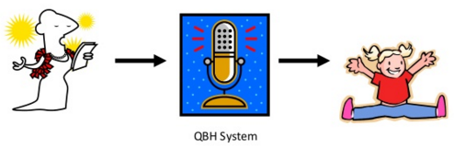
ABSTRACT
Allows the user to find a song by singing or humming part of the tune.
The idea is simple: you hum into the microphone, the computer records the hum and extracts certain features corresponding to the melody and rhythm characteristics, and it then compares the features to the features of the songs in the database.
Finally it returns a ranked list of top 5 Songs or Melodies from the database which are most similar to the humming.
GOAL: To build a reliable and efficient largescale system that collects thousands of songs and responds in seconds.

Slide 3
INTRODUCTION
A lot of research in audio-based search engines, and building efficient Human Computer Interfaces
The purpose of this project is to build a complete functional prototype of a Query by Singing/Humming system.
However, building such a system, presents significantly greater challenges because unlike text content, the way to represent and store melody content in a database does not work here.
Moreover, several issues unique to QbSH systems are:
Users may not make perfect requests.
Difficult to capture pitches and notes from user’s query
Difficult to capture accurately the melodic information from a pre-recorded music file
Difficult to avoid Noise.

Slide 4
PROBLEM SPECIFICATION
The situation of not being able to find a song to which we have a melody running on our minds is known to everyone. i.e. we have some idea of the tune and we need to identify the song.
To handle above situation, we need a Query by Singing/Humming (QbSH) system.
This system needs to be robust to handle :
Poor humming
Wrong pitch
Wrong note duration
Noise and distortion

Slide 5
PROPOSED METHODOLOGY
The major algorithmic modules are the extraction of a melody representation from the query (and also the database songs at the time of creating the database), and the melodic similarity distance computation. Hence we divide the system into two major layers.

Slide 6
PROPOSED METHODOLOGY (Cont..)
LAYER 1:
In this layer the user hums the required query .
The query is recorded and stored as a .WAV file.
This file is then fed to the SWIPE function/AubioYIN function.
This function accepts the query and gives the Pitch Contour of the hummed query along with the list of fundamental frequencies.
Detailed Pitch Contour Analysis along with efficient use of algorithms helps in extracting the midi notes from the hummed query.

Slide 7
PROPOSED METHODOLOGY (Cont…)
LAYER 2:
In this layer a Database Schema consisting of the string in “uUsdD” format (Parson’s Code) generated by the midi notes is stored with their frequencies, midi notes etc.
Their Pitch Contour Analysis is done using SWIPE and the notes extracted are stored in the database.
Thus, the string extracted from Layer 1 is matched against the string of Layer 2 using the edit distance Pattern Matching Algorithm.
The system returns the top 5 best matched melodies (in ascending order of their distances) to the requested query.

Slide 8
INFORMATION EXTRACTION AND ANALYSIS
Our database would be essentially an indexed set of sound tracks.
The user-hummed query is typically a few notes hummed or sung by the user.
In order to find the ranked list of the songs that matches this user input, this query is processed to detect its melody line.
This output list of matching melodies can be used to retrieve the desired soundtrack.

Slide 9
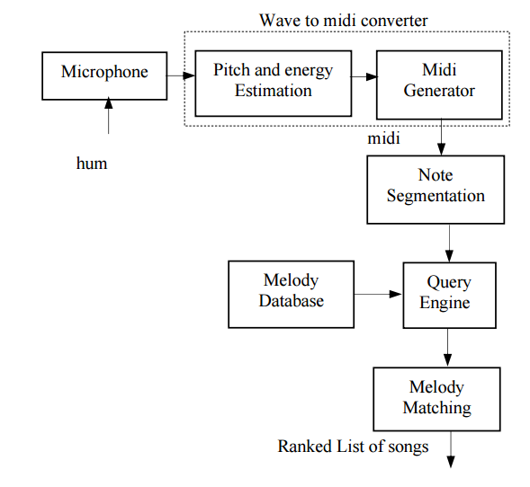
SYSTEM ARCHITECTURE

Slide 10
DETAILS
PITCH EXTRACTION : SWIPE (Sawtooth waveform inspired pitch estimator), YIN
PREPROCESSING : High notes (U, u), Low Notes(D, d) & Same Notes(S)
PATTERN MATCHING: EDIT DISTANCE ALGORITHM (Dynamic Programming)

Slide 11
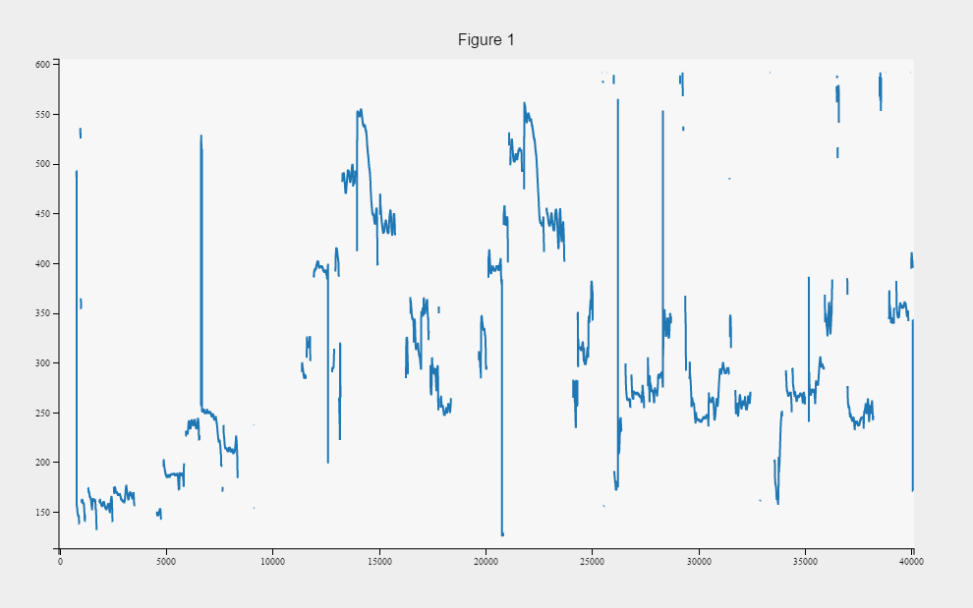

SWIPE: FEATURE EXTRACTION
The resultant example pitch contour for qbh_examples.wav

Slide 12
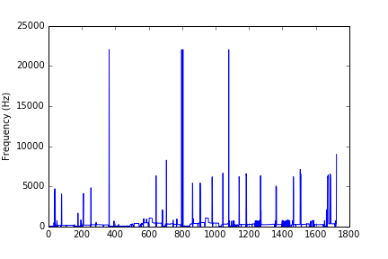
YIN: FEATURE EXTRACTION
The resultant example pitch contour for qbh_examples.wav

Slide 13

SQLite: DATABASE
SQLite is an in-process library that implements a self contained, serverless, zero-configuration, transactional SQL database engine.
The main reason for choosing SQLite is that it reads and writes directly to ordinary disk files and does not have a separate server process.
TURN TO DEMO

Slide 14
GUI : DEMO

Slide 15
SYSTEM SPECIFICATIONS
Front end
* For GUI → PyQt
* SWIPE → Python
* YIN → Marysas and Python
Backend
* For data base →SQLite

Slide 16
EVALUATION
The system is fetching good results with the query being a hum tune or with any syllable or if even sung in words or recorded with the phone.
SWIPE pitch extraction is taking approximately 2 minutes. So we implemented YIN algorithm which is taking 2-3 seconds.

Slide 17
RESULTS
After testing 10 times for each Query Type.
Query Type | SWIPE’ | YIN
Hummed | 70% | 80%
Hummed with 1 syllable | 80% | 90%
Sung with words | 80% | 90%
Actual Song (device) | 80% | 90%

Slide 18
FUTURE WORK
Implement DTW (Dynamic Time Warping) concept instead of edit distance algorithm by Dynamic Programming.
Improve pitch extraction and pattern matching algorithm so that the system will perform quickly with at least 500 songs in the database.
Develop as a web application so that it can be accessed on server publically.
Merge SWIPE and YIN into the same system so that the user can chose which pitch extraction method to use.

Slide 19
REFERENCES
[1] M. A. Raju, B. Sundaram, and P. Rao, TANSEN: A Query-By- Humming based Music Retrieval System, In Proc. National Conference on Communications (NCC), 2003.
[2] Alan V.Oppenheim and Ronald W. Schafer, Discrete-time Signal Processing, Prentice Hall, Fourth Edition.
[3] About SQLite. https://www.sqlite.org/about.html.
[4] Amiya Kumar Tripathy, Neha Chhatre, Namrata Surendranath, and Manpreet Kalsi. Query by humming system. Int. Journal of Recent Trends in Engg, 2009.
[5] Edmond Lau, Annie Ding, Calvin On, MUSICDB:A Query By humming system
[6] Sumantra Dutta Roy, Preeti Rao, Contour based melody representation: An analytical study.
[7] John G.Proakis, Digital Signaling and Processing, Prentice Hall, Fourth Edition.
[8] http://en.wikipedia.org/wiki/Query by humming. (Accessed on 11 September 2007)
[9] PyQt Tutorials. https://wiki.python.org/moin/PyQt/Tutorials.
[10] http://www.cs.cornell.edu/Info/Faculty/bsmith/query-byhumming.html. (Accessed on 13 January 2008)
[11] Arturo Camacho and John G Harris. A sawtooth wave-form inspired pitch estimator for speech and music. The Journal of the Acoustical Society of America, 124(3):1638–1652, 2008.
[12] Roger B Dannenberg, William P Birmingham, George Tzanetakis, Colin Meek, Ning Hu, and Bryan Pardo. The musart testbed for query-by-humming evaluation. Computer Music Journal, 28(2):34–48, 2004.

Slide 20
QUESTIONS ?

Slide 21


